Slide 1



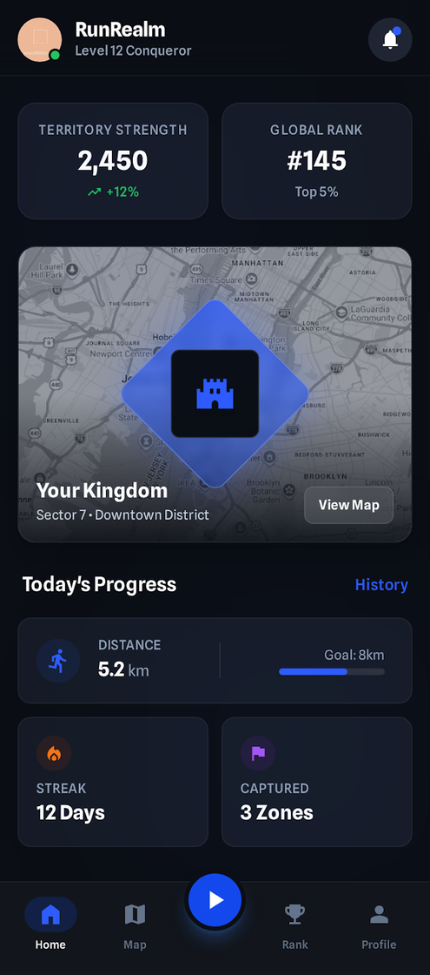


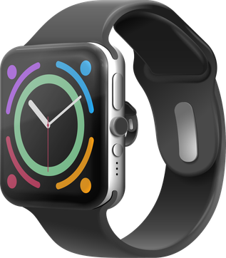

RUNREALM
The World’s First Real-World Territory Conquest Running Game
A fitness-tech startup building behavior-driven digital experiences that increase real-world consistency through game mechanics and social competition.
Founded in India. Built for the world.
Start Presentation

Slide 2


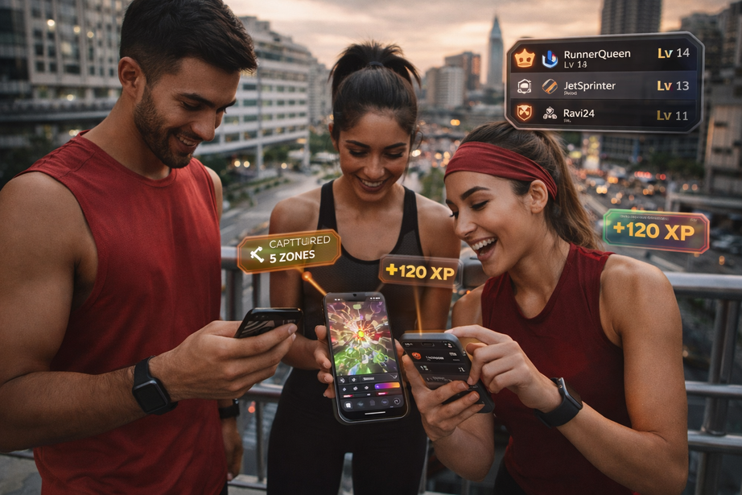
RETENTION CRISIS IN FITNESS APPS
Despite growing awareness about health and wellness, most fitness app users fail to stay consistent beyond the first few weeks.
High Churn Rate
80–90% of fitness app users drop off within 90 days. Low retention directly limits Lifetime Value (LTV).
No Consequence for Inconsistency
Missing workouts has no structural impact.
There is no ownership, no loss, no accountability loop.
Lack of Emotional Engagement
Most apps track steps and calories —
they do not create identity, competition, or long-term progression.
Urban users (18–35) in Tier 1 & 2 cities seek gamified, social, and competitive experiences — not passive tracking tools.

Slide 3
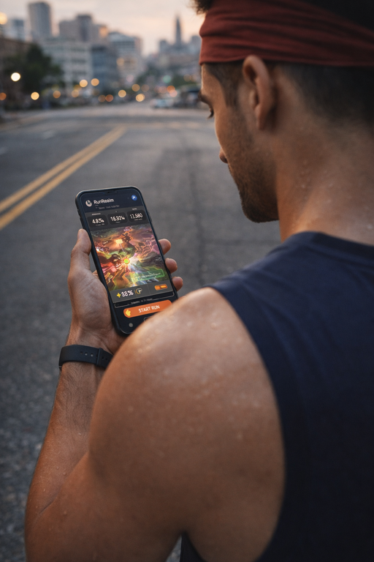

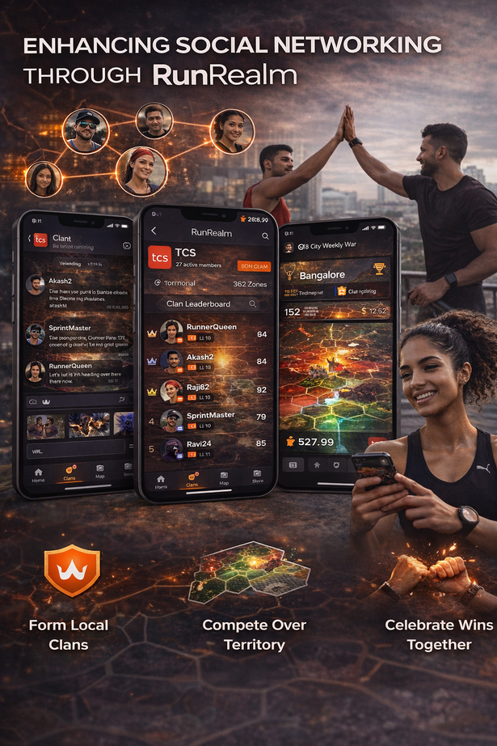
$150M
A BEHAVIOR-LOCKED FITNESS GAMING PLATFORM
India’s fitness-tech + mobile gaming intersection represents a multi-million dollar early-stage opportunity.
RunRealm transforms physical movement into persistent digital ownership. Every kilometer captures territory. Every streak strengthens control. Consistency becomes strategy — not willpower.
Built-In Retention Engine
Urban users spend on:
Performance tracking
Social competition
Digital upgrades
Gamified engagement
Territory decays without activity.
Loss aversion reinforces habit formation.
Social Network Effects
Clans and city wars create competitive density.
More users in a city = higher engagement loops.
Monetizable Digital Economy
RunRealm sits at the convergence of fitness, gaming, and social identity.
Progression is earned through running. Revenue comes from cosmetics, battle passes, and sponsored territory events — not pay-to-win mechanics.

Slide 4
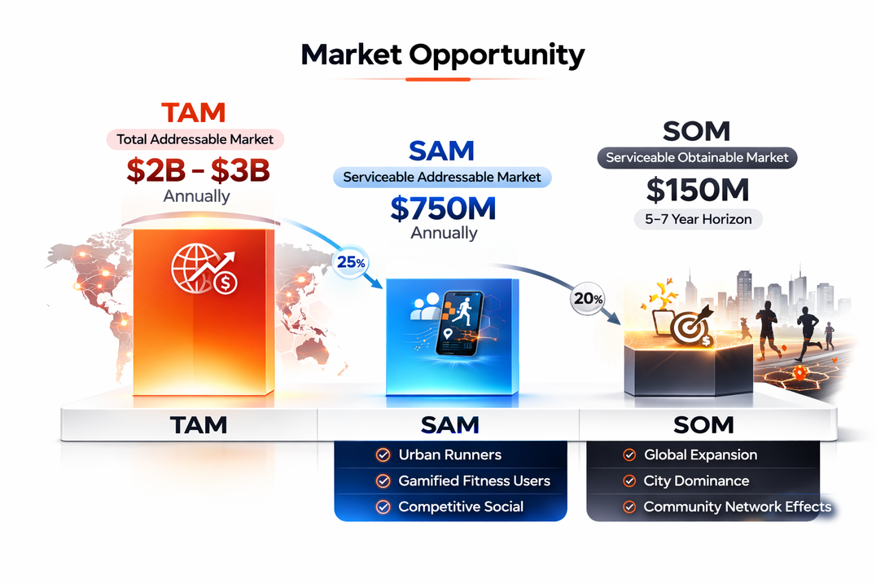
THE PRODUCT / SERVICE (CURRENT STAGE)
STAGE: VALIDATED CONCEPT + DESIGNED MVP
RunRealm has completed problem validation and product-market hypothesis testing within the target demographic (18–35, Tier 1 & 2 India).
We have:
• Defined core game mechanics (territory, decay, clan system)
• Designed full mobile UI/UX flows
• Structured monetization framework
• Identified scalable city-based rollout model
What Is Built
What Is Next
Complete UI prototype
Core gameplay logic framework
Retention loop architecture
Revenue model blueprint
Backend game engine development
GPS-based grid implementation
Closed beta launch (City 1)
Retention testing & iteration
The global fitness app market is projected to surpass $30B by 2030, growing at ~17% CAGR, while the mobile gaming industry already exceeds $180B annually. Despite strong demand, fitness apps experience 70–80% user churn within the first 90 days, significantly limiting LTV.
There are an estimated 200M+ active runners globally, with approximately 50M digitally engaged through tracking platforms and wearables. This digitally active cohort represents a monetizable intersection of fitness and gaming behavior, where structured gamification can materially improve retention and ARPU expansion.

Slide 5


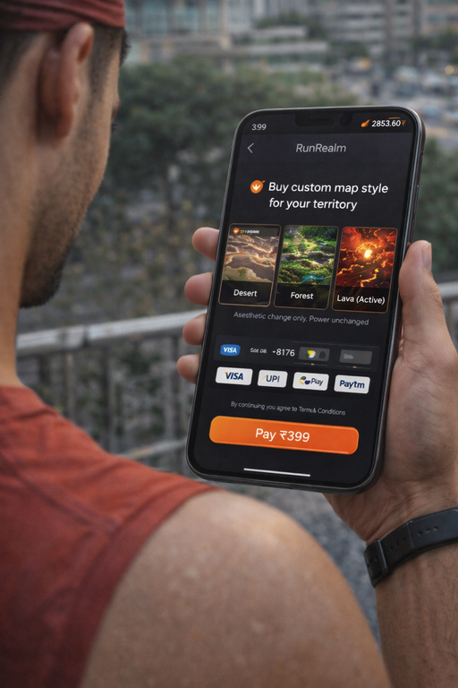
FREEMIUM + SOCIAL GAMING MONETIZATION
Battle Pass (₹199/month)
Cosmetic Microtransactions
• Exclusive territory skins & seasonal themes
• Advanced performance analytics & heatmaps
• Clan progression boosts & private war access
• Early access to new features
→ Recurring revenue layer built on engaged users
• Custom map themes (Urban, Terrain, Satellite variants)
• Kingdom style upgrades
• Territory border effects
• Avatar customization & badges
→ High-margin digital goods
→ Non pay-to-win
→ Identity-driven purchases
Sponsored Territory Events
Corporate Wellness (Phase 2)
• Brand-sponsored city conquest campaigns
• Sports & fitness brand collaborations
• Sponsored landmarks & reward zones
• Event-based prize pools
→ Location-based brand integration
→ Engagement + advertising hybrid model
• Private company clans
• Team fitness competitions & leaderboards.
→ B2B expansion layer
→ Higher ARPU segment
→ Scalable across metro cities
High retention → Higher LTV
Engagement-first monetization → Sustainable margins

Slide 6

VALUE PROPOSITION
For the Users
For the Market
Converts exercise into ownership, not obligation
Reinforces habit through structured loss aversion
Turns solo fitness into competitive social identity
Makes consistency visible, measurable, and rewarding
Structurally reduces fitness app churn
Increases retention through embedded gamification loops
Expands monetization beyond subscriptions into digital goods & events
Operates at the intersection of India’s fast-growing fitness-tech and mobile gaming sectors
RunRealm transforms running from a task into a progression system.
RunRealm creates a new engagement category: Real-World Competitive Fitness.

Slide 7
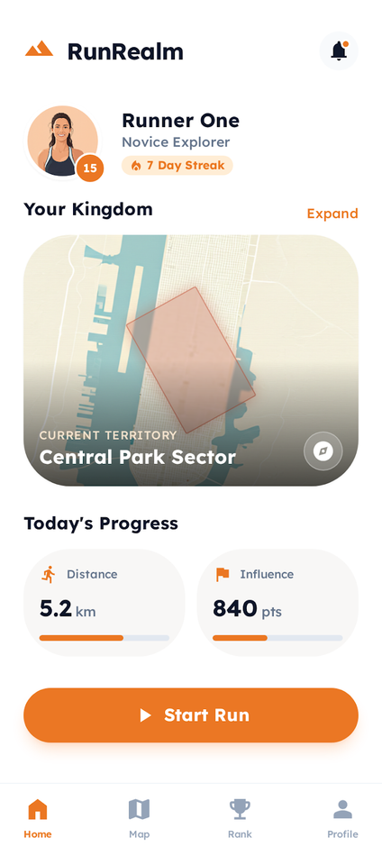
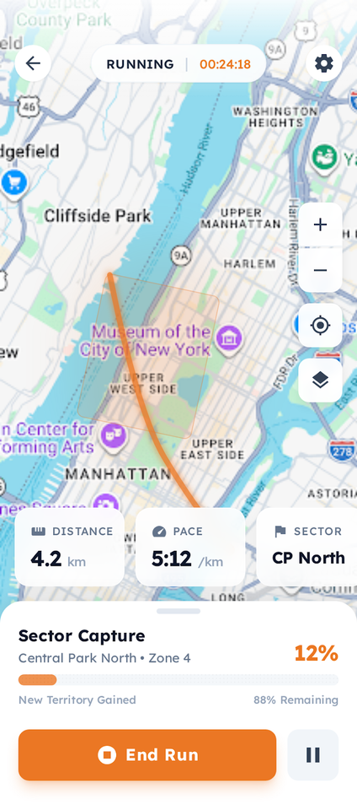


RunRealm converts physical activity into a structured progression loop.
Users begin from a personalized dashboard, transition into live territory capture through GPS-based gameplay, and unlock advanced features through a premium layer designed for serious runners.
The flow demonstrates our core engagement engine:
Action → Ownership → Progression → Monetization.
This structure drives retention through visible growth, competitive motivation, and optional premium upgrades — without compromising fair gameplay.

Slide 8





THANK YOU FOR YOUR TIME.
Say hello to our founding team!
Aryan Singh
Asmi Gupta
Vedanshi Dabbawala
Aditya Tiwari
Technical Lead
Project & Operations Lead
Design & UX Lead
Product & Strategy Lead

